Slide 1
Traffic Stops in Montgomery County, MD

Slide 2
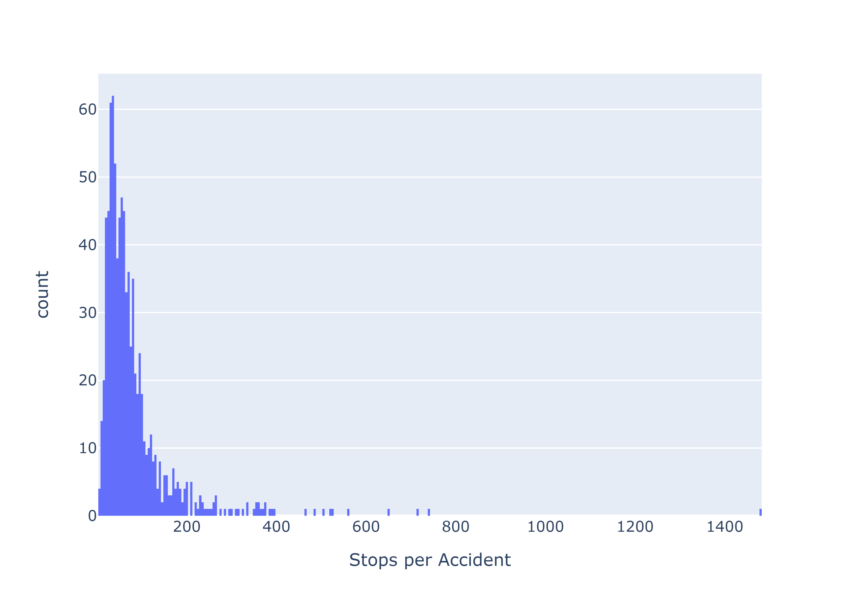
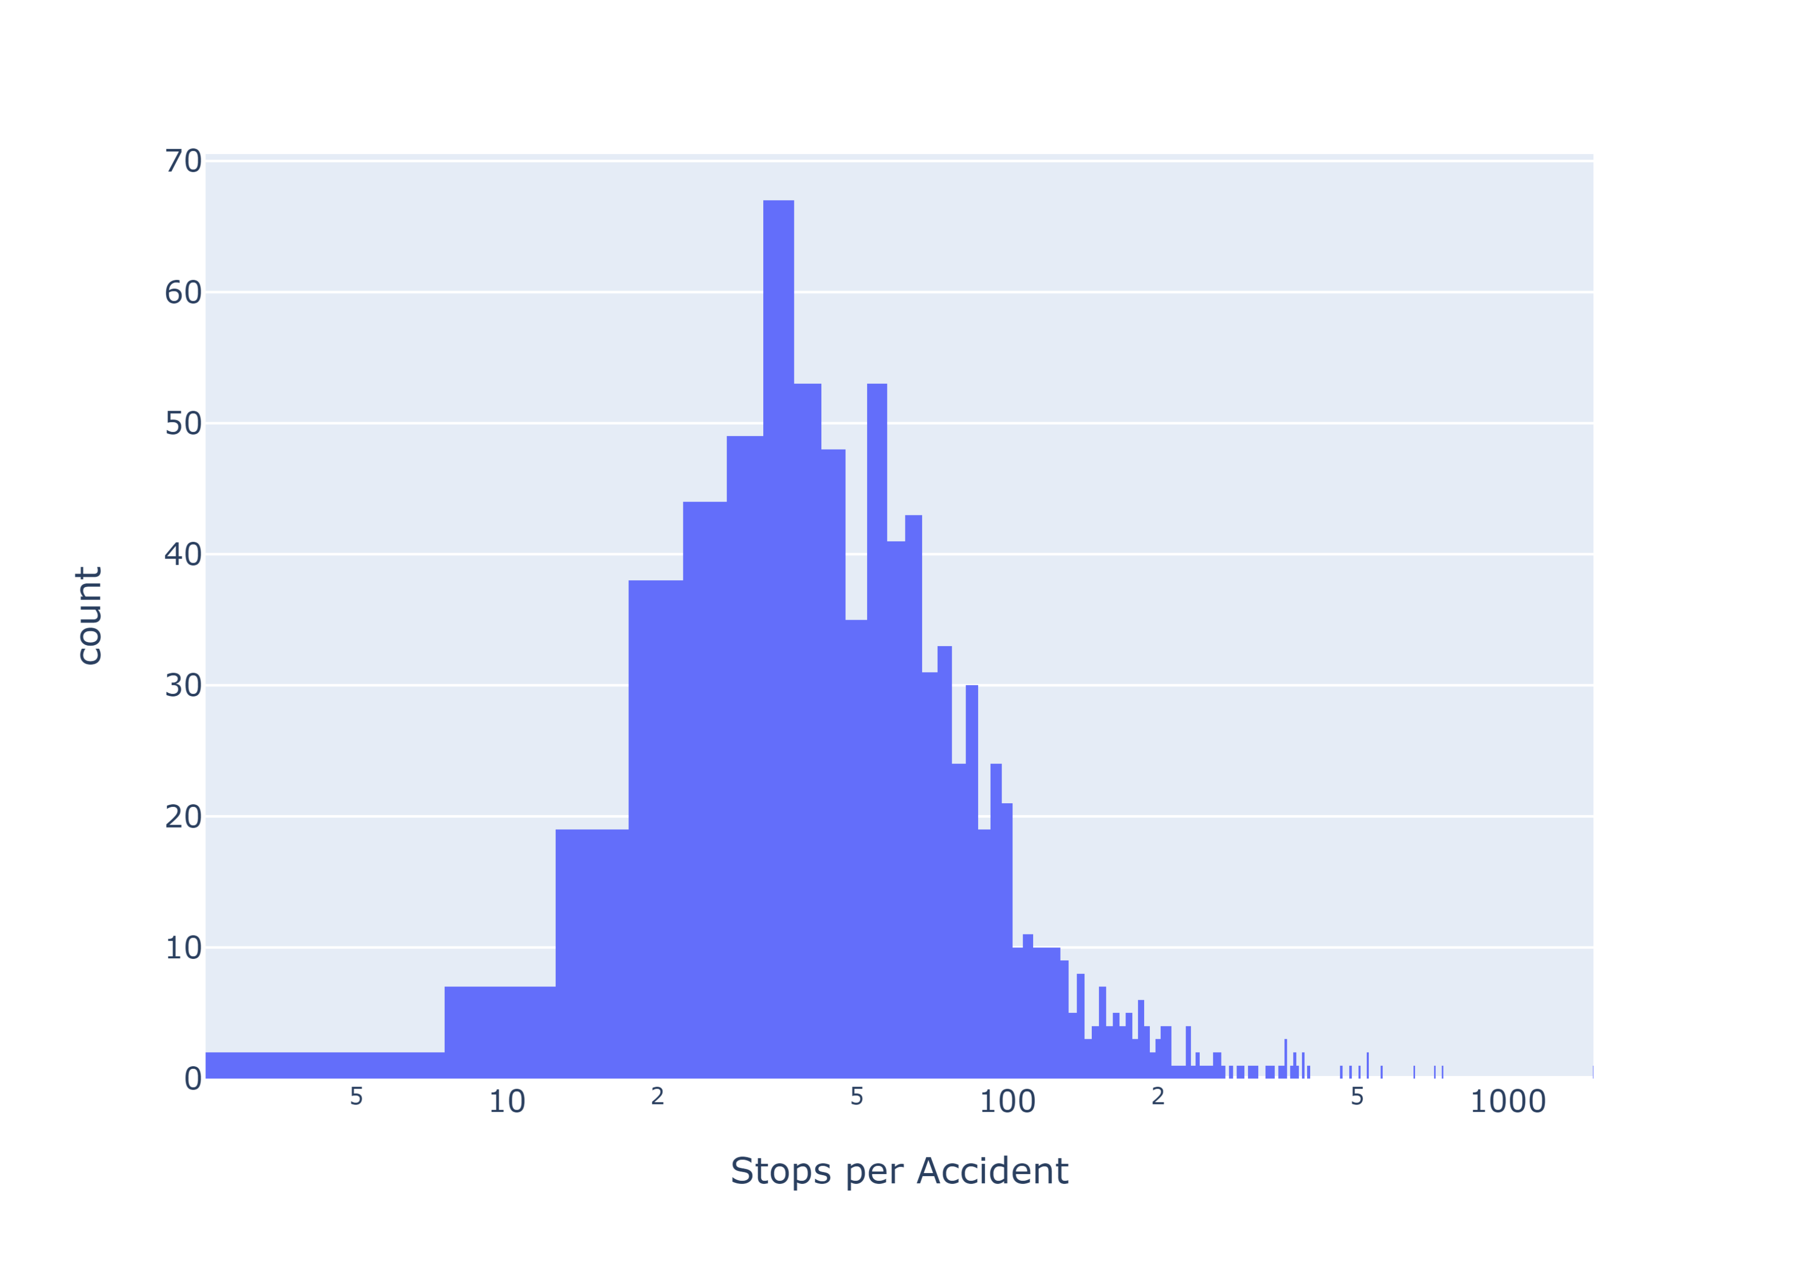
Where do Traffic Stops Occur?
Note: limited to areas with >= 150 stops

Slide 3
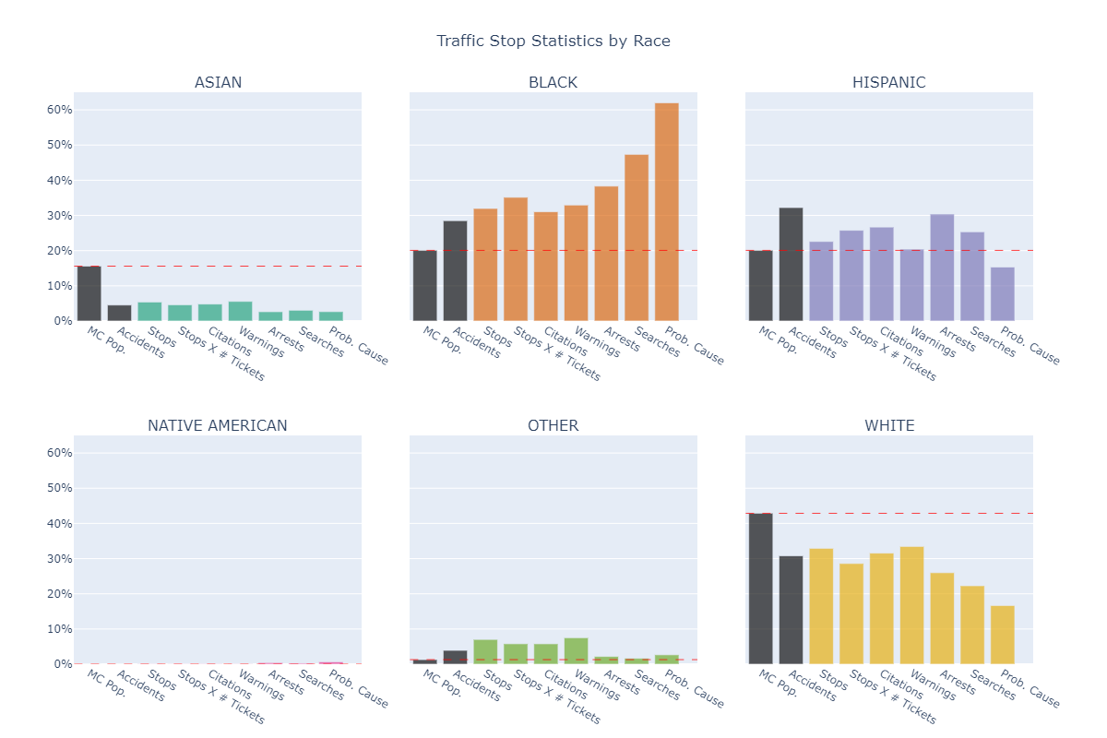
Summary Statistics by Race
Bars are the percentage that this race accounts for.
“MC Pop.” and “Accidents” are driver population estimates.

Slide 4
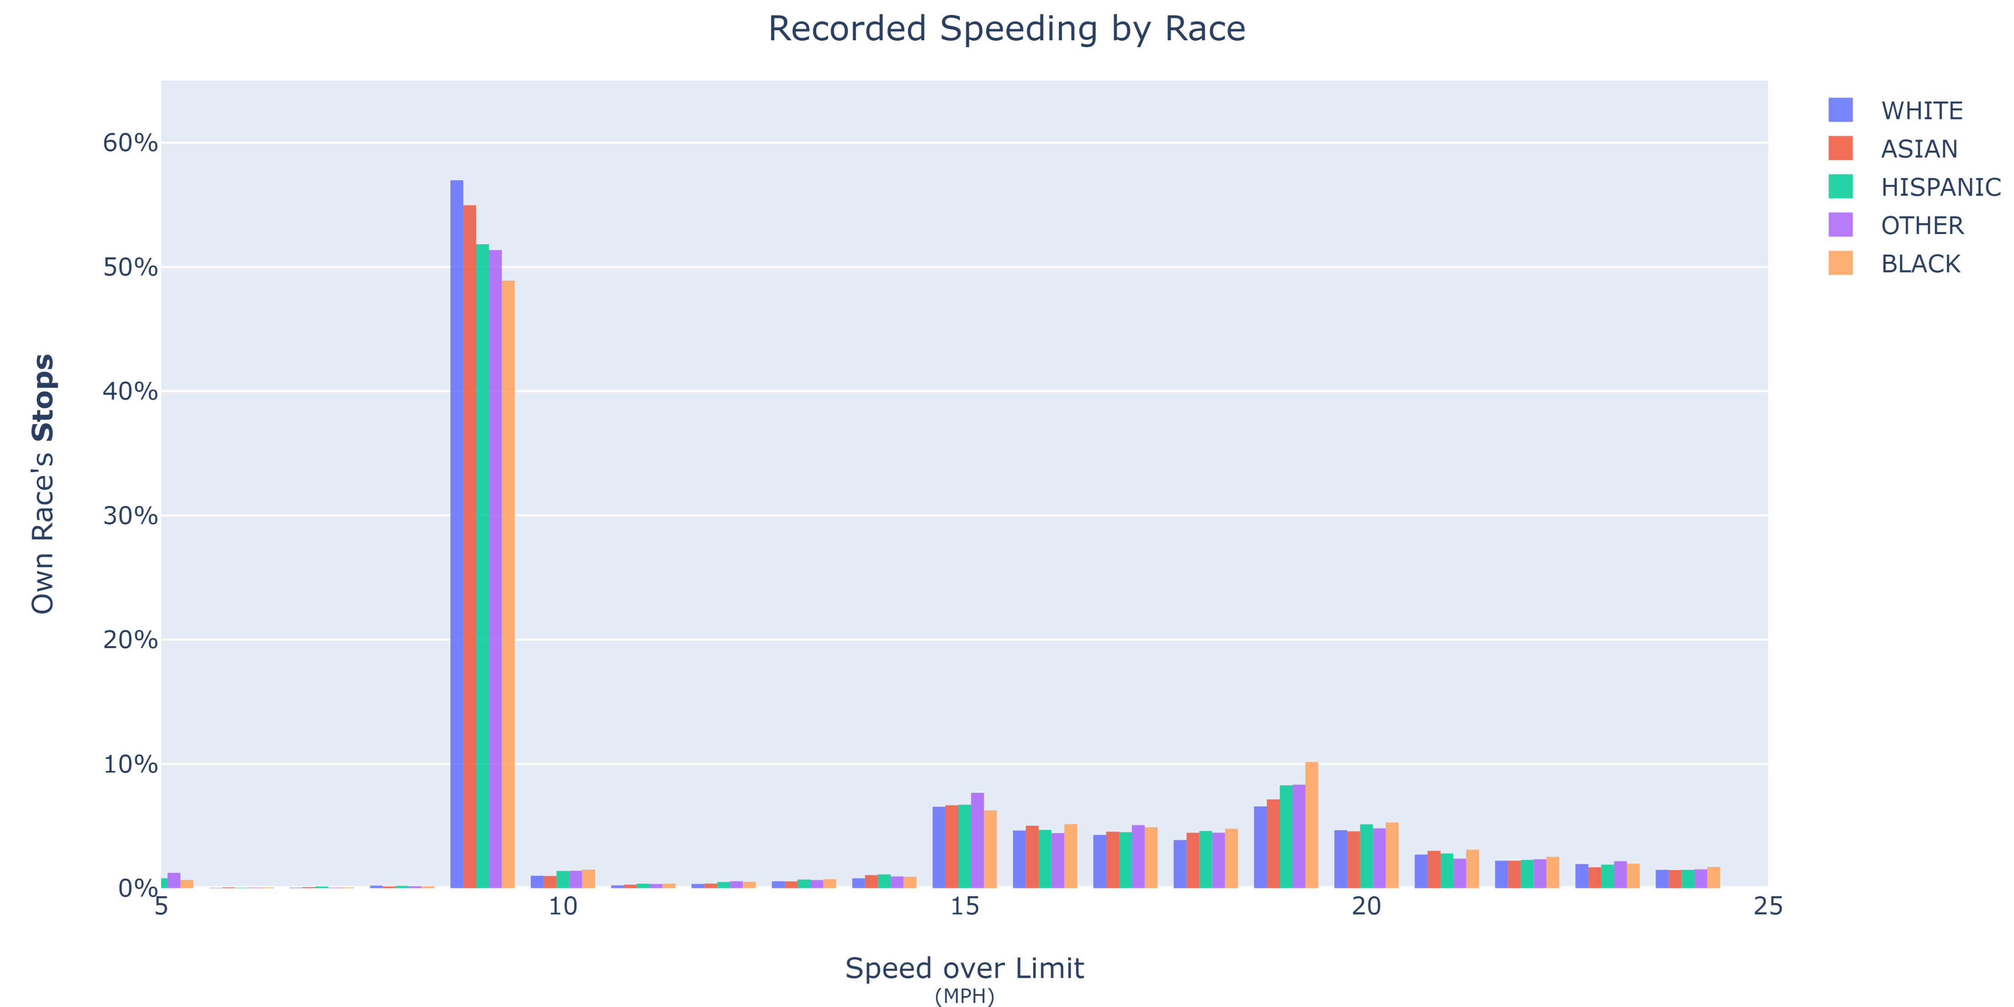
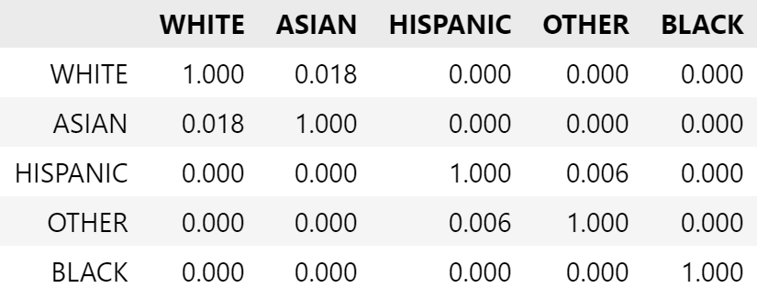
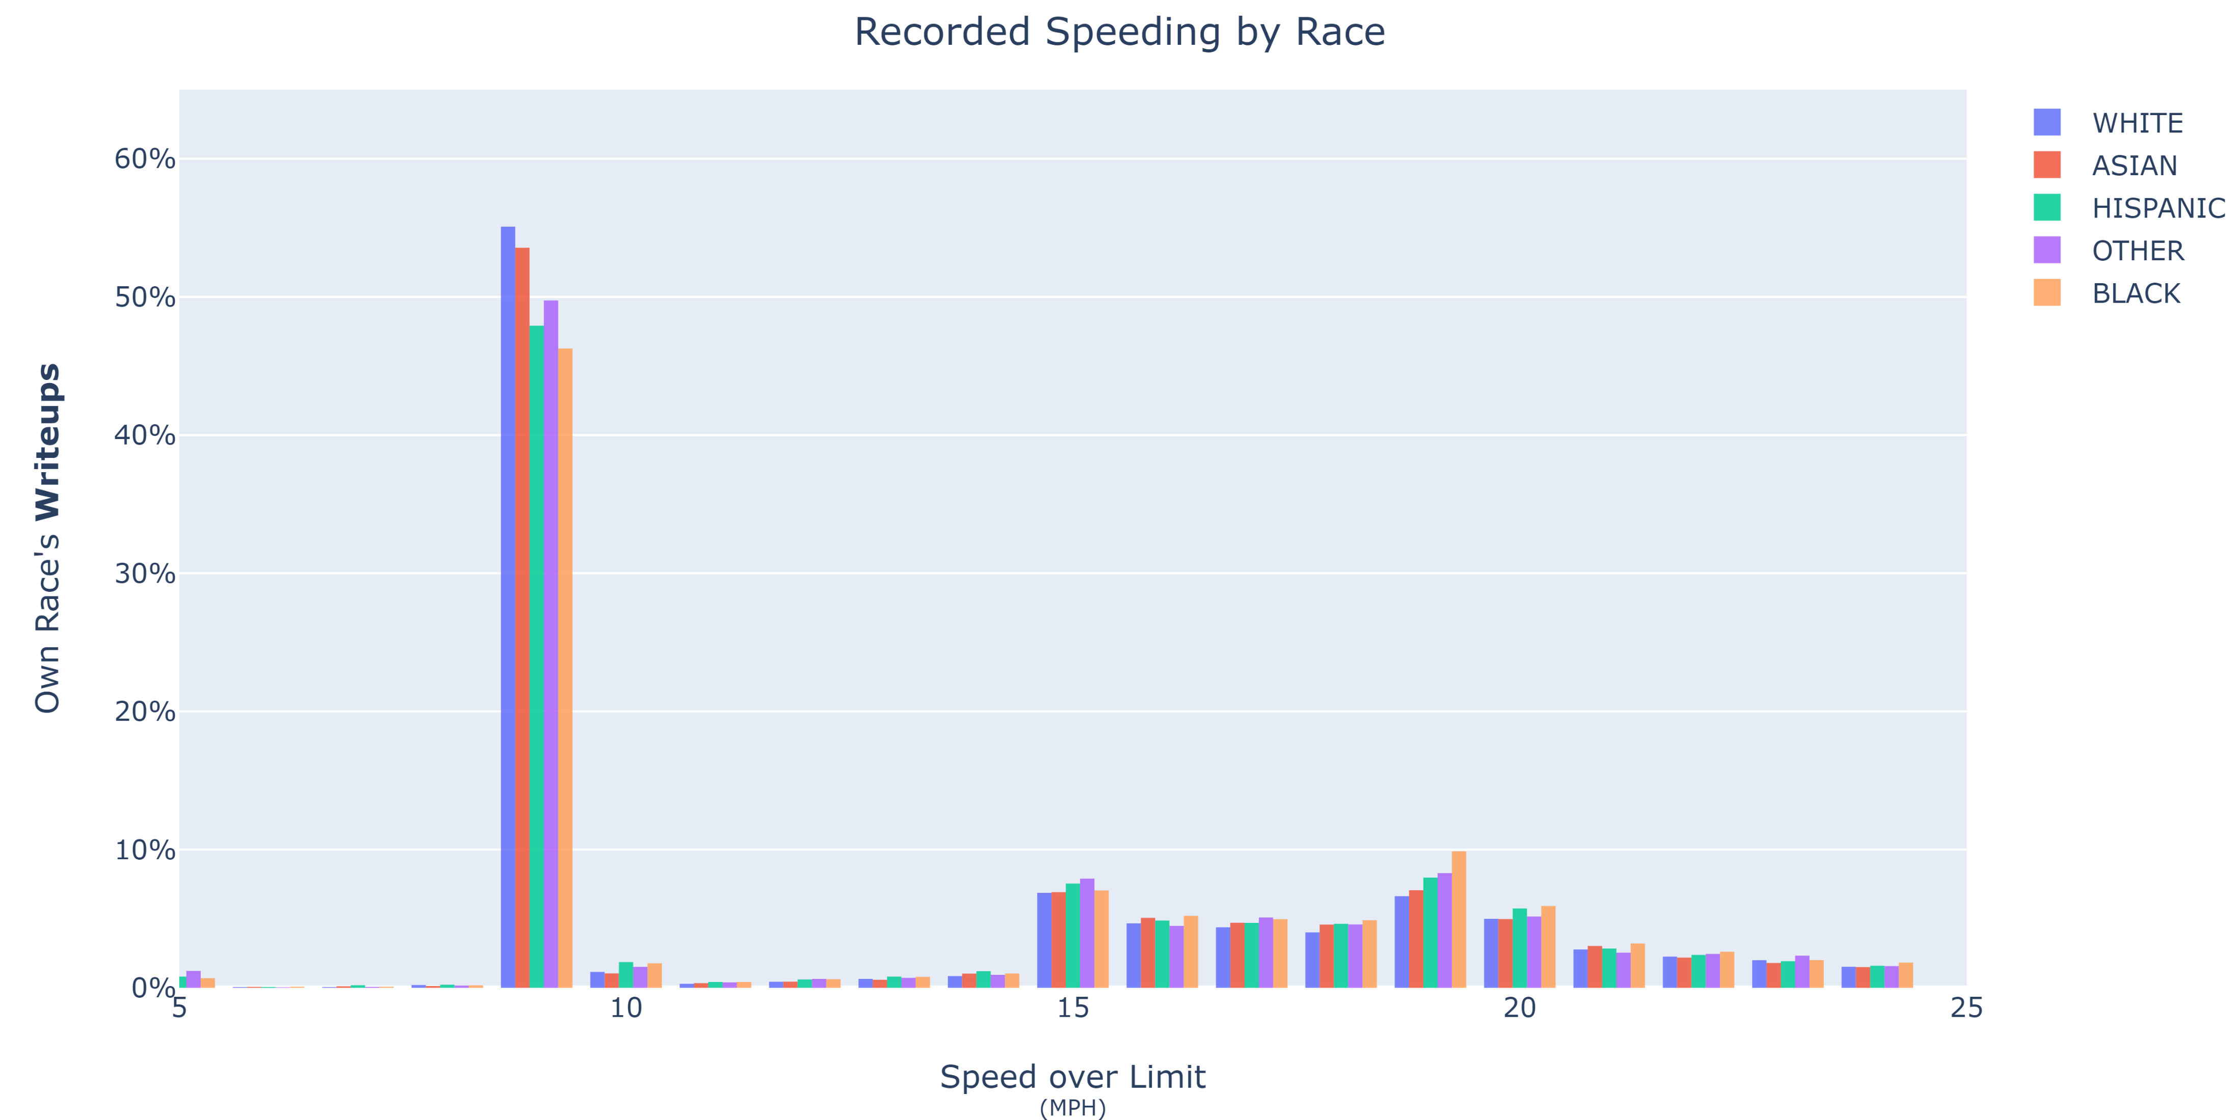
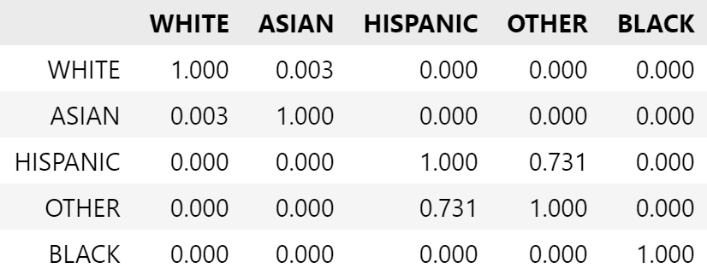
Do all races receive the same preferential treatment?
P-values at 9 mph

Slide 5
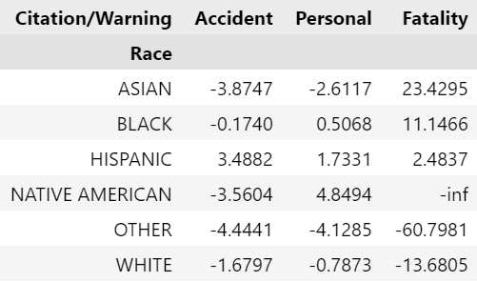
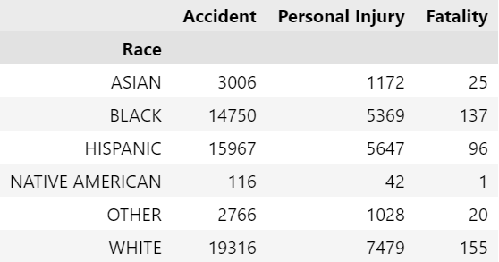
Expected vs. Actual Citation Frequencies
N
% Difference

